Slide 1
Local Government Tobacco-Free Policies:
From Challenge to Success
Month DD, 2017

Slide 2
What we will cover
Why tobacco-free policies are important
Local tobacco-free policy progress
Success Stories
Call to action

Slide 3
Why tobacco-free policies are Important
1

Slide 4
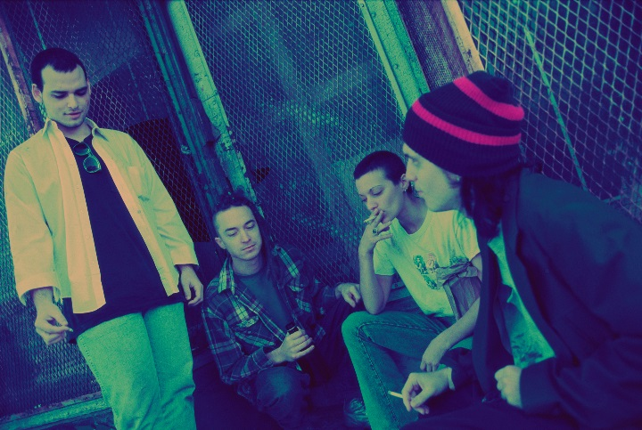
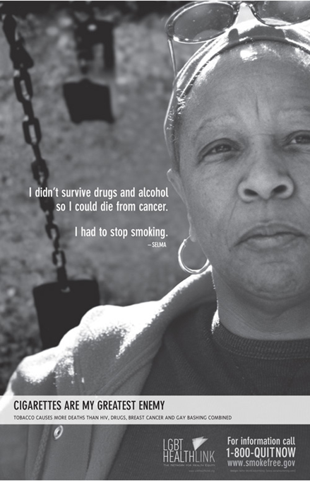
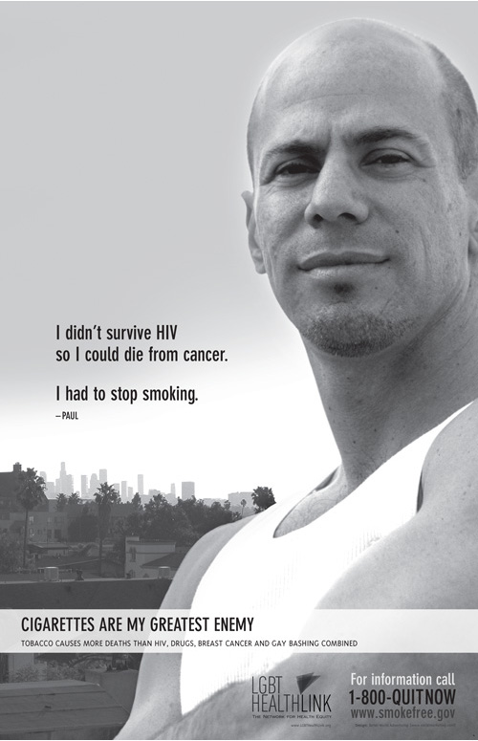
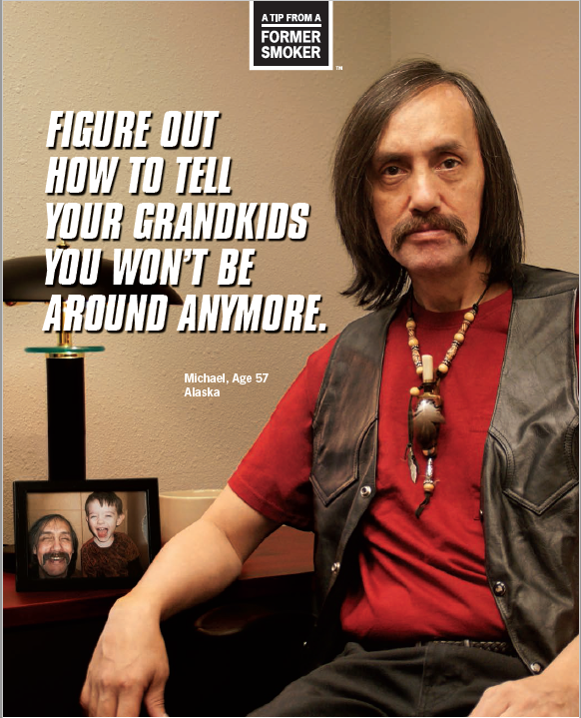
Who Is Still Left Using Tobacco Products?
Notes:
(Thinkstock 57569622) Over time science has shown that people who smoke cigarettes are much more likely to develop – and die from – certain diseases than people who don’t smoke. And despite the warnings, more than 20 million Americans have died from smoking since the that first report in 1964.
From a health equity perspective I really like the way Washington State Department of Health is reframing questions like “Why do people smoke?” Instead from a population health perspective we must examine, “What social and environmental stresses prompt people to smoke?”
A major stressor is that in the communities where we still see smoking the most, there is also more tobacco advertising and usually cheaper prices and the marketing works. Tobacco companies have spent billions of dollars refining and marketing the cigarette. As a result, cigarettes have become more deadly and more addictive over these past 50 years.
Over the past decade the percentage of current adult smokers has declined in NC. Based on the Behavioral Risk Factor Surveillance System (BRFSS) data, 19.1%, of NC adults were current cigarette smokers in 2015, a decline from 21.8% in 2011.
However, data show those who are low-income, less educated, male, adults between the ages of 18-24, African American, and American Indian residents of NC are more likely to smoke than others. Further, high smoking rates among persons with mental illness, substance abuse and/or disability issues and among lesbian, gay, bisexual and transgender (LGBT) populations constitute large health disparities in vulnerable populations. This data is similar to national tobacco-related disparities.
Pregnant women are also a vulnerable population identified in NC.

Slide 5

Tobacco Use is a Social Injustice Issue
Notes:
This year the Truth Initiative launched a campaign about why tobacco use is a social injustice issue.
Despite fewer teens smoking than ever before, tobacco is still a massive health issue and it affects some communities a lot more than others.
And it’s no coincidence that rates among certain communities are higher. It’s a result of the decades of targeting by the tobacco industry, designed to hook them on a deadly product.
Why? Read ad on slide.
Source: Truth Initiative, Social Injustice Toolkit

Slide 6
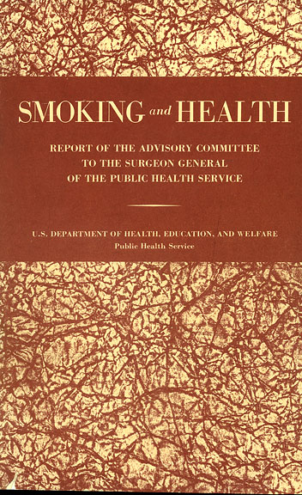
Smoking Causes
Lung Cancer
1964
2006
2014
2016
Notes:
Fifty years ago Dr. Luther Terry shocked the nation when he released the first Surgeon General’s report that linked smoking to lung cancer and heart disease. In January, the 32nd Surgeon General’s Report on smoking and health was released.

Slide 7
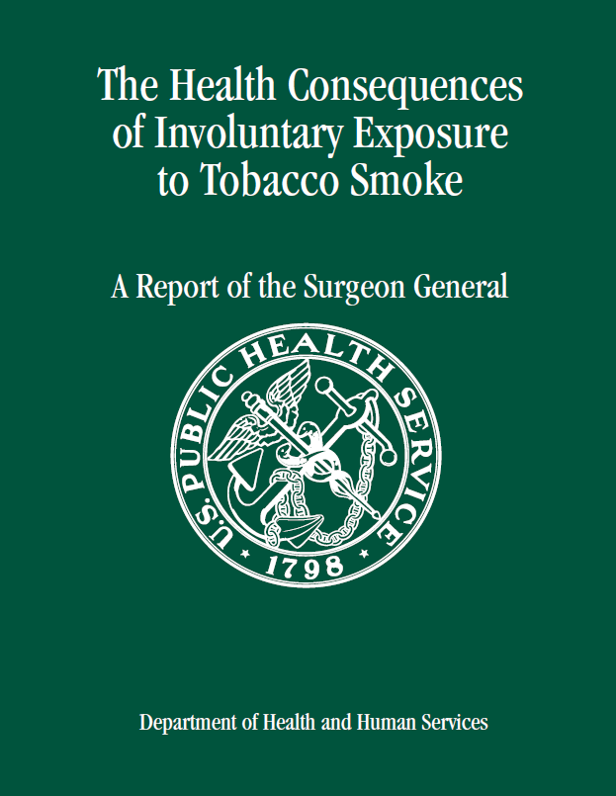
There is No Safe Level of Secondhand Smoke Exposure
1964
2006
2014
2016
Notes:
In 2006, the scientific evidence showed that there is no risk-free level of exposure to secondhand smoke. This data was instrumental in building support for smoke-free policies such as NC’s Smoke-Free Restaurants and Bars Law.

Slide 8
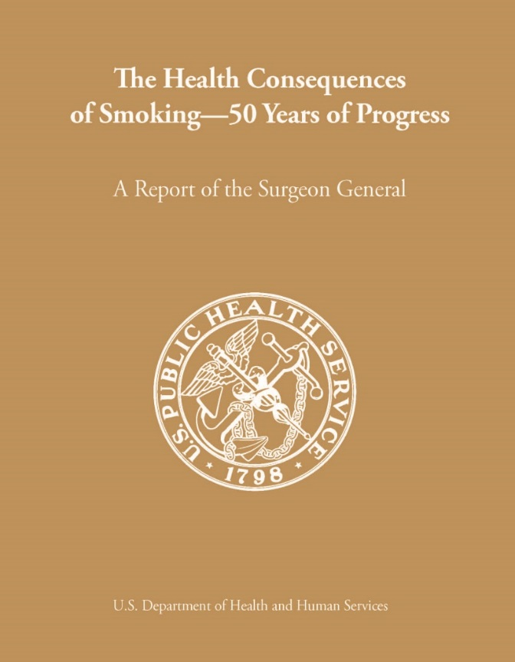
Smoking Damages Nearly Every Part of the Body
1964
2006
2014
2016
Notes:
The 2014 report provides more evidence of the serious damage smoking does to the human body. It also commemorates the anniversary of that first report that laid the foundation for today’s programs to reduce the disease and death caused by smoking.

Slide 9
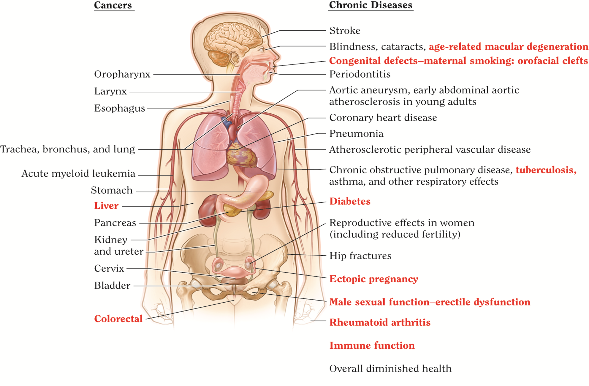
Notes:
The take home message from this diagram which you can find in the 2014 Surgeon General’s Report is that the reason cigarette smoking is so deadly is that it causes disease in nearly every organ of the body.
The diseases highlighted in red are new findings in the 2014 Report. For example until 2014, we did not know conclusively that smoking causes diabetes.
The danger of smoking comes from inhaling chemical compounds, some in the tobacco and some that are created when tobacco is burned. The process used to make modern cigarettes includes the use of many harmful chemicals.
In all, scientists have identified more than 7,000 chemicals and chemical compounds in tobacco smoke. At least 70 of them are known to cause cancer.
Some of those chemicals speed and enhance the absorption of nicotine – which is the primary agent in tobacco that causes addiction.
Most of these deaths were of adults with a history of smoking but two and a half million were of people did not smoke but who died because they breathed in secondhand smoke from other people’s cigarettes.
Source: The health consequences of smoking – 50 years of progress: a report of the Surgeon General. – Atlanta, GA. : U.S. Department of Health and Human Services, Centers for Disease Control and Prevention, National Center for Chronic Disease Prevention and Health Promotion, Office on Smoking and Health, 2014.

Slide 10
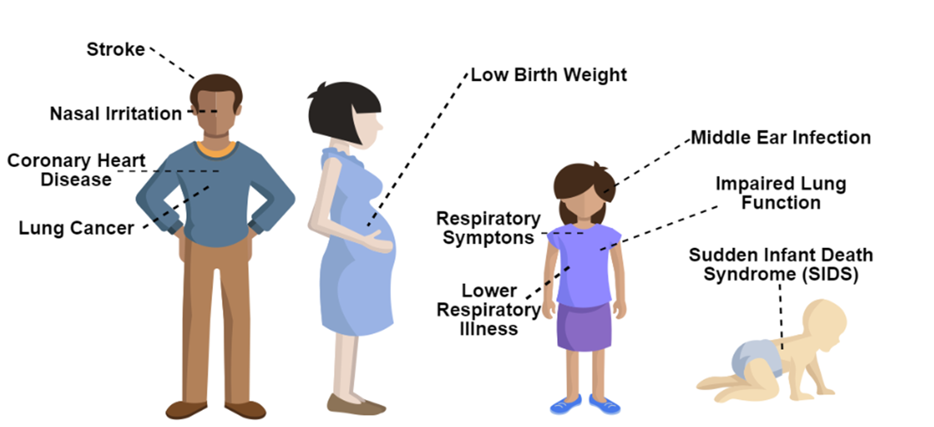
Secondhand Smoke Impacts Everyone
Notes:
Being around an active smoker presents a significant health risk to those who do not smoke.
This because Secondhand smoke contains the same toxins that those actively smoking inhale and it kills more than 42 thousand nonsmokers a year in this country.
The science in 50 years of Surgeon General’s Reports has also removed notion that there might be such a thing as a “safe” cigarette. All cigarettes are harmful, and any exposure to tobacco smoke can cause both immediate and long-term damage to the body.
The Bottom line is that: There is no safe level of exposure to tobacco smoke, and there is no safe cigarette!
That is evident by the fact that more than 100,000 of the smoking-related deaths were of babies who died from Sudden Infant Death Syndrome or other health conditions caused by smoking in the home or during pregnancy.
Data sourced from CDC Tobacco Fact Sheet: http://www.cdc.gov/tobacco/data_statistics/fact_sheets/secondhand_smoke/health_effects/
Source: The health consequences of smoking – 50 years of progress: a report of the Surgeon General. – Atlanta, GA. : U.S. Department of Health and Human Services, Centers for Disease Control and Prevention, National Center for Chronic Disease Prevention and Health Promotion, Office on Smoking and Health, 2014.

Slide 11
E-cigarette aerosol is not harmless
1964
2006
2014
2016
Notes:
The Report was released December 8, 2016 in Washington, D.C. by U.S. Surgeon General Dr. Murthy and is based on science.
There has never been an U.S. Surgeon General’s Report that was not based on science or that had to go back and recall any of the information that was include and according to Dr. Brian King, that was one reason why this report was not released until now so that everything included was conclusive sound science.
We know from previous research that 9 in 10 adults who smoke first try conventional cigarettes during adolescence and this could extend to e-cigarettes as well (USDHHS 2012)

Slide 12

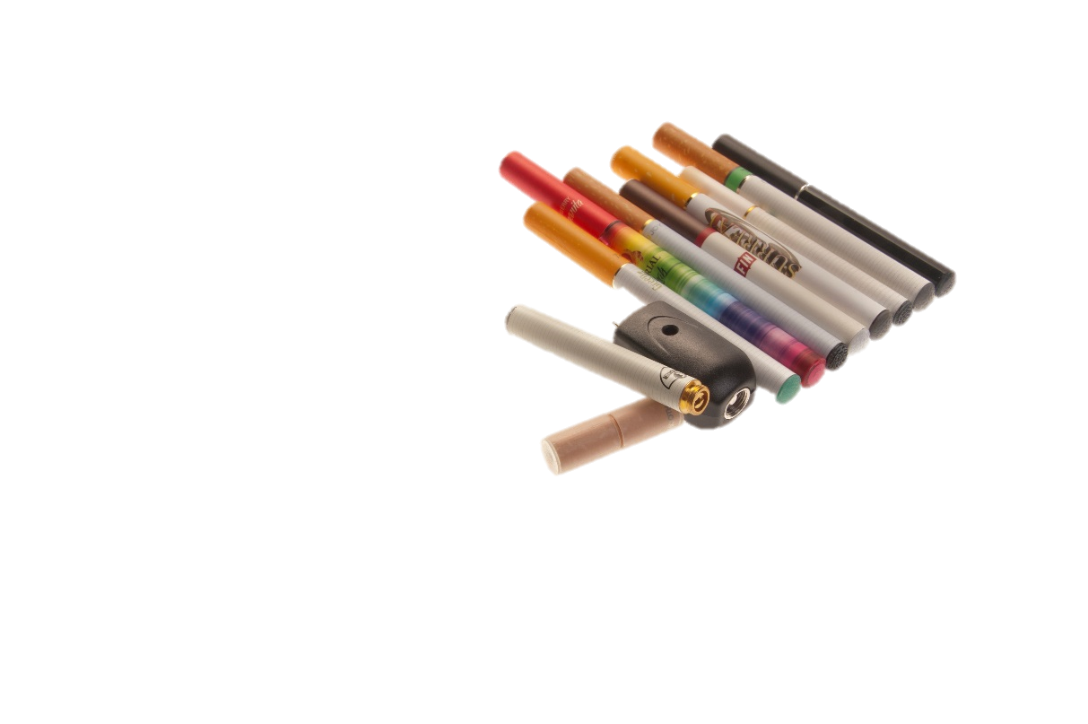
E-Cigarette Aerosol Contains Harmful &
Potentially Harmful Ingredients
Nicotine
Fine Particulate
Volatile Organic Compound
Heavy Metals
Other Compounds
Notes:
Slide courtesy of Dr. Brian King, CDC

Slide 13

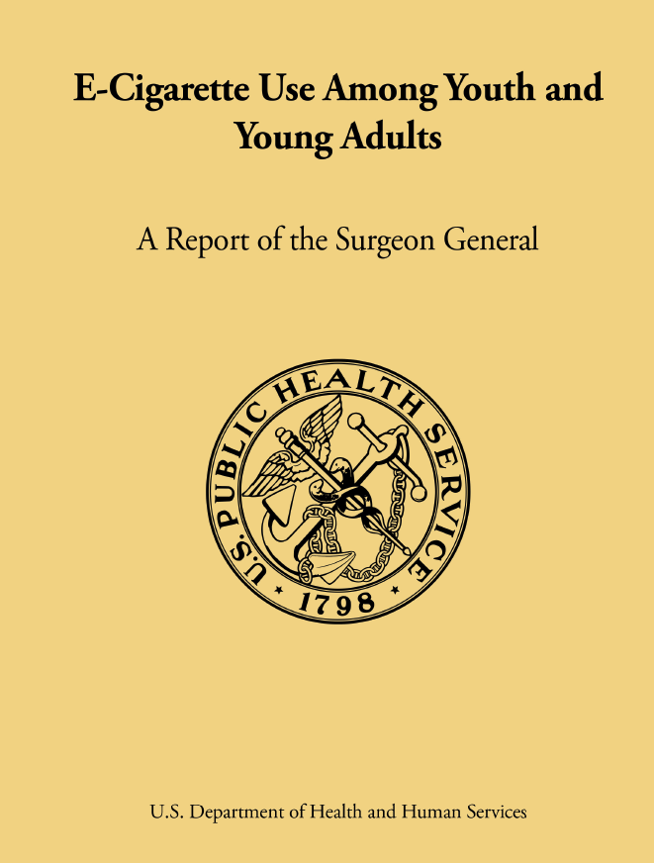
The Surgeon General’s Report
Chapter 2 Conclusion 8.
E-cigarette products can be used as a delivery system for cannabinoids and potentially for other illicit drugs.
Notes:
Slide courtesy of Dr. Brian King
“I was on the train from New York to Baltimore and I enjoyed the pen the whole way there and back with no one noticing," said one life-long marijuana user who asked not to be identified. "I absolutely was thinking 'This is not bad at all.”
Source: NBC New York. http://www.nbcnewyork.com/news/local/ECigarettes-Drugs-Marijuana-Vapor-Pens-Smoking-I-Team-227269001.html
Approximately 1/3 of students who had ever used an e-cigarette (32.5%) reported having used (at least once) an e-cigarette for a substance other than nicotine.

Slide 14
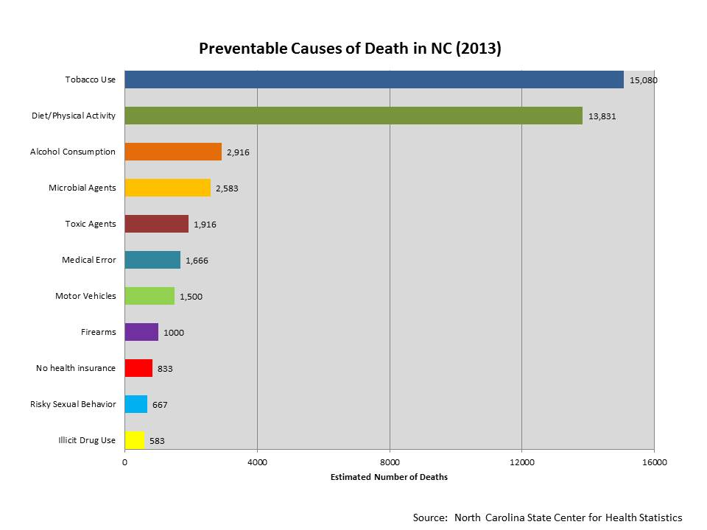
Tobacco Use Is the Leading Preventable Cause of Death in NC (SCHS)
Notes:
State Center for Health Statistics, 2013

Slide 15
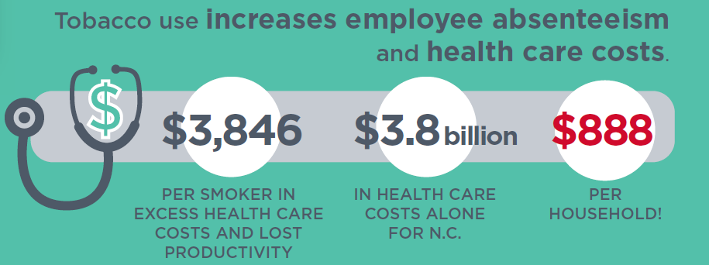
Tobacco Use Costs Everyone

Slide 16
Barriers Exist to Reducing Tobacco Use
Tobacco easily accessible
Smoking in public legal
Unfettered advertising
Poor access to cessation help
Individual
Tobacco Addiction
Society
Notes:
Slide courtesy of Dr. Brian King, CDC

Slide 17
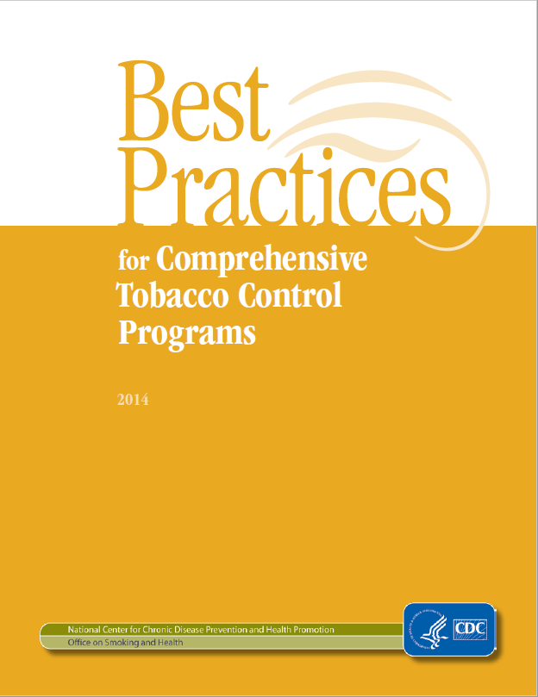
“Tobacco Control Vaccine” Works
Tobacco Price Increases
Cessation
Access
100% Smoke-Free Policies
Hard Hitting Media Campaigns
Notes:
Slide courtesy of Dr. Brian King, CDC
Source: Centers for Disease Control and Prevention. Best Practices for Comprehensive Tobacco Control Programs. 2014

Slide 18

The Community Preventive Services Task Force recommends smoke-free policies to:
Reduce exposure to secondhand smoke;
Reduce the prevalence of tobacco use;
Increase the number of tobacco users who quit;
Reduce the initiation of tobacco use among young people;
Reduce tobacco-related morbidity and mortality, including acute cardiovascular events; and
Reduce healthcare costs substantially.

Slide 19
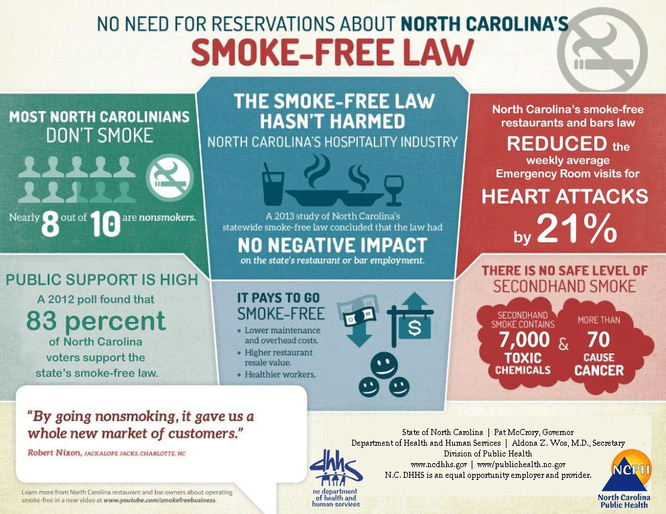

Slide 20
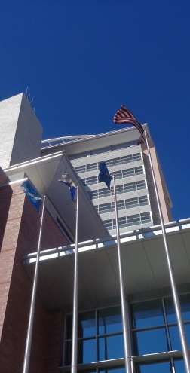
Local Governments Have Authority to Regulate Smoking in Local Government Buildings
“A building owned, leased or occupied by a local government” G.S. §130A-492(8):
Health Department Buildings;
Courthouses;
Police Departments;
County Libraries; and
Other government facilities.
Notes:
Think Image from original presentation

Slide 21

Local Governments Have Authority to Regulate Smoking in Local Vehicles
“A passenger-carrying vehicle owned, leased, or otherwise controlled by local government” G.S. §130A-492(9)
County and Municipal Vehicles and
Buses
Notes:
Think Stock Image from original presentation

Slide 22

Local Governments Have Authority to Regulate Smoking on Local Government Grounds
“An unenclosed area owned, leased or occupied by local government” G.S. § 130A-492(6)
Grounds next to city or county government buildings;
Parking lots;
Parks;
Sidewalks maintained/controlled by the city or county;
Bus stops; and
Other outdoor facilities.
Notes:
Thinkstock 89486397

Slide 23




Local Governments Have Authority to Regulate Smoking in Public Places
“An enclosed area to which the public is invited or in which the public is permitted” G.S. §130A-492(14)
Grocery stores;
Shopping centers;
Banks;
Gaming facilities;
Bowling centers;
Movie theaters; and
Other places where
the public is permitted.
Notes:
Thinkstock:
BankAmerica Tower 91841174 Bowling: 77738480 Movie: 638236110 Groceries: 78180656

Slide 24
Local governments may adopt and enforce ordinances restricting or prohibiting smoking that are more restrictive than state law
Board of County Commissioners
May adopt an ordinance that applies to unincorporated areas, and
If city agrees, ordinance may apply within incorporated areas
Municipal Governing Board
May adopt an ordinance that applies within the city limits, and
May pass a resolution agreeing to have county ordinance apply within the city

Slide 25
Local boards of health may adopt and enforce rules restricting or prohibiting smoking that are more restrictive than state law
Local Board of Health / District Board of Health
Rules apply throughout the county or district
Rule must be approved by an ordinance adopted by the Board of County Commissioners (BOCC)
After BOCC approves the rule by ordinance, it applies throughout the county
No additional action or approval of city or town councils is required
Notes:
It is the opinion of the NC Attorney General’s Office and of lawyers from the NC School of Government that the BOCC is merely “approving” the rule of the Board of Health.
The Board of Health rule remains a rule after it is approved by the BOCC and applies to the county and the municipalities.

Slide 26
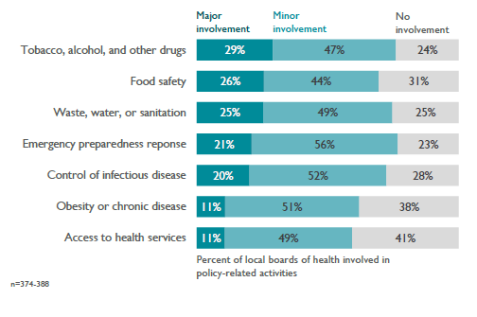

Local boards of health are most likely to be involved in policies related to tobacco, alcohol, or other drug use
Notes:
This data collected by the National Association of County and City Health Officials shows that boards of health are most likely to be involved in policies related to tobacco, alcohol, and other drug use more than any other area.
NACCHO 2015 Local Board of Health Profile

Slide 27
Local governments can prohibit the use of smokeless tobacco and e-cigarettes
The legislature has never passed legislation pre-empting local governments from regulating the use of e-cigarettes (or smokeless forms of tobacco), which are not lighted.
Therefore, local governments can pass such regulations under their basic authority to pass regulations to protect the health and welfare of the community.
Boards of Health are regulating smokeless tobacco and e-cigarettes under general authority given in NCGS § 130A-39
If a regulation for government buildings and/or grounds covers all “tobacco products”, then our interpretation is that e-cigarettes are included within that definition.

Slide 28
Local Tobacco-Free Policy Progress
2

Slide 29
Healthy 2020 Goal Progress
Notes:
By 2020, North Carolina aims to increase the percentage of counties and municipalities that have adopted 100% SF or TF policy to 100% for government buildings, 70% for government grounds (50% for municipalities), and 50% for indoor public places.

Slide 30
Local Smoke-Free / Tobacco-Free Policy Progress 2012 - 2016
Notes:
In 2014 the increase in smoke-free / tobacco-free policies may have been related to the Community Transformation Grant activity that came to a close that year. More staff, capacity and funding on the ground helps build momentum for policy change.

Slide 31
Overall Status Report for Smoke-free/Tobacco-free Places as allowed by NC law: 1) government buildings, 2) grounds, and 3) vehicles; 4) parks; 5) recreation areas; 6) entertainment centers; and 7) public places.

Slide 32
Overall Status Report – Urban vs. Rural Counties
Notes:
More urban counties have adopted 5-7 policies and more rural counties have adopted no policies. The challenges in the rural areas include the history and culture of tobacco farming ties in the community.

Slide 33
Number of County Polices Adopted by Region
Notes:
Region 9’s success in smoke-free / tobacco-free policies may be related to the additional funding that they received from CDC for the Partnerships Improving Community Health (PICH) grants. Again, funding and staff capacity helps build momentum for policy change.

Slide 34
Smoke-Free and Tobacco-Free County Polices Adopted by Type
Notes:
Incremental progress is a success as long as it does not shut any doors to future progress. A majority of the smoke-free / tobacco-free policies adopted cover county buildings and vehicles. Counties may then decide to take it a step further and prohibit smoking and tobacco use on government grounds since it usually becomes an issue outside as well.

Slide 35
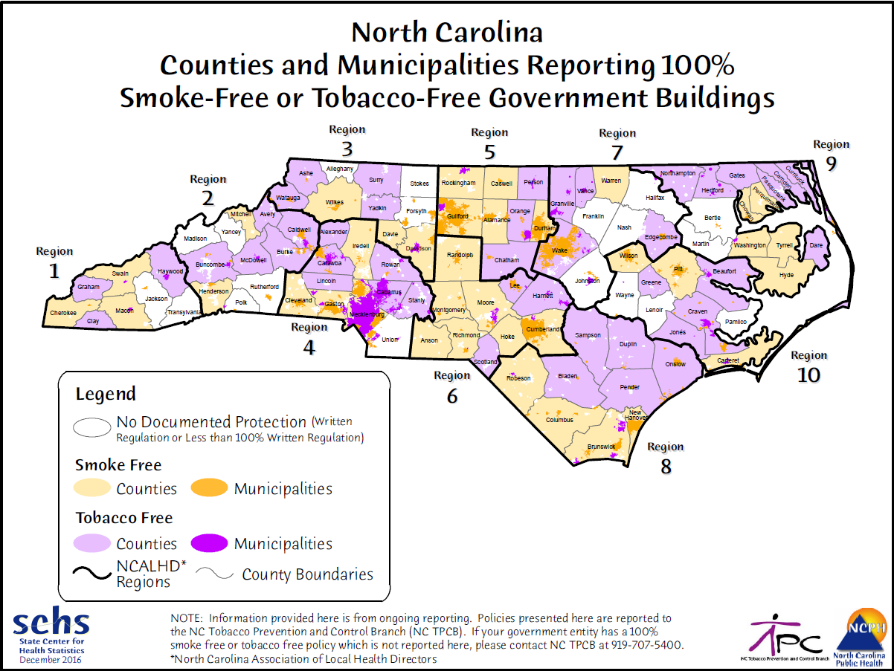
Notes:
A major priority for the Tobacco Prevention and Control Branch is to get all county government buildings covered by a comprehensive smoke-free policy. You can see from this map that counties without a comprehensive smoke-free / tobacco-free policy are generally located in tobacco growing and tobacco manufacturing areas of the state.

Slide 36
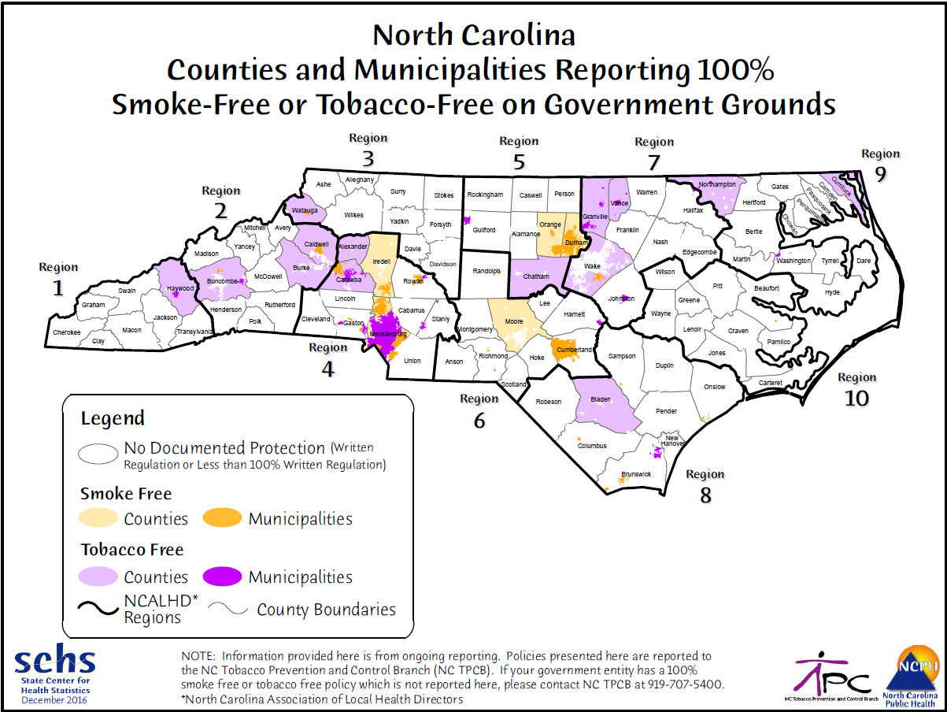

Slide 37
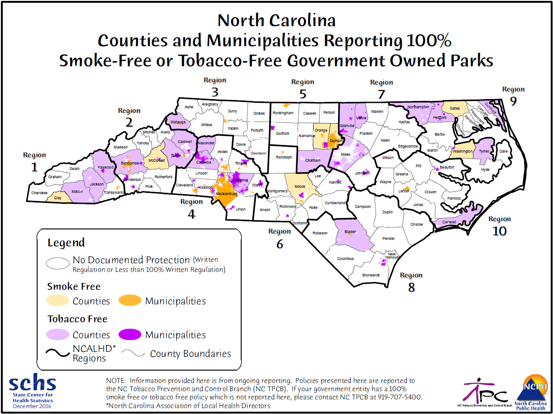

Slide 38
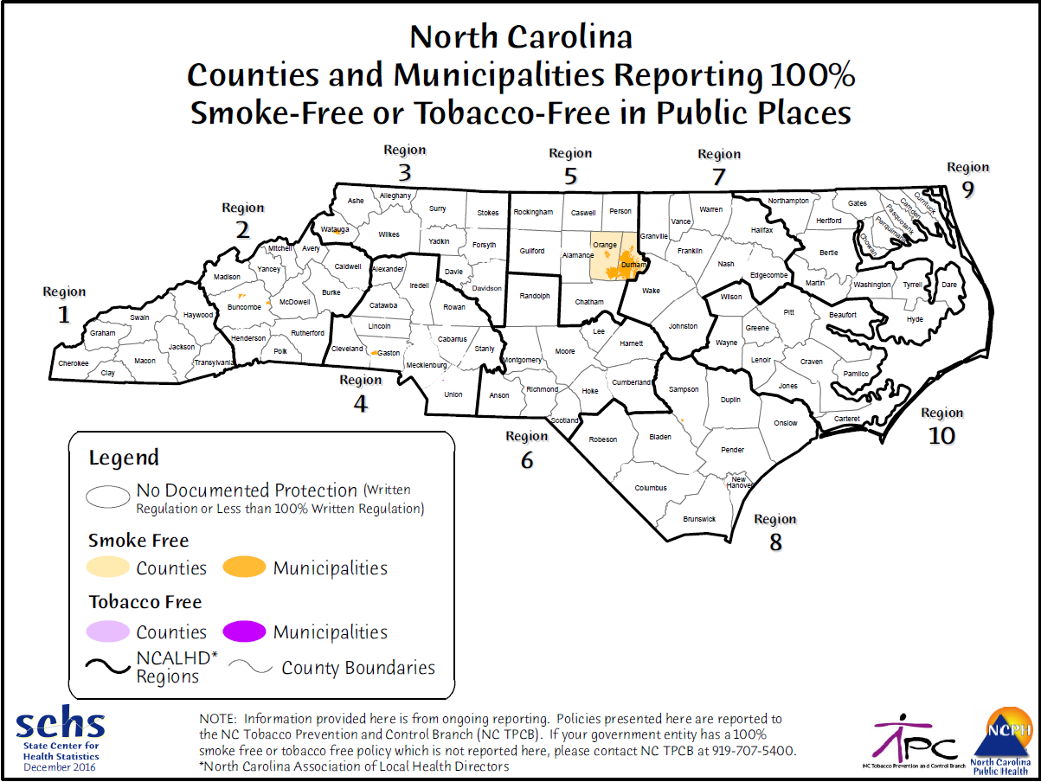

Slide 39
Success Stories
3

Slide 40
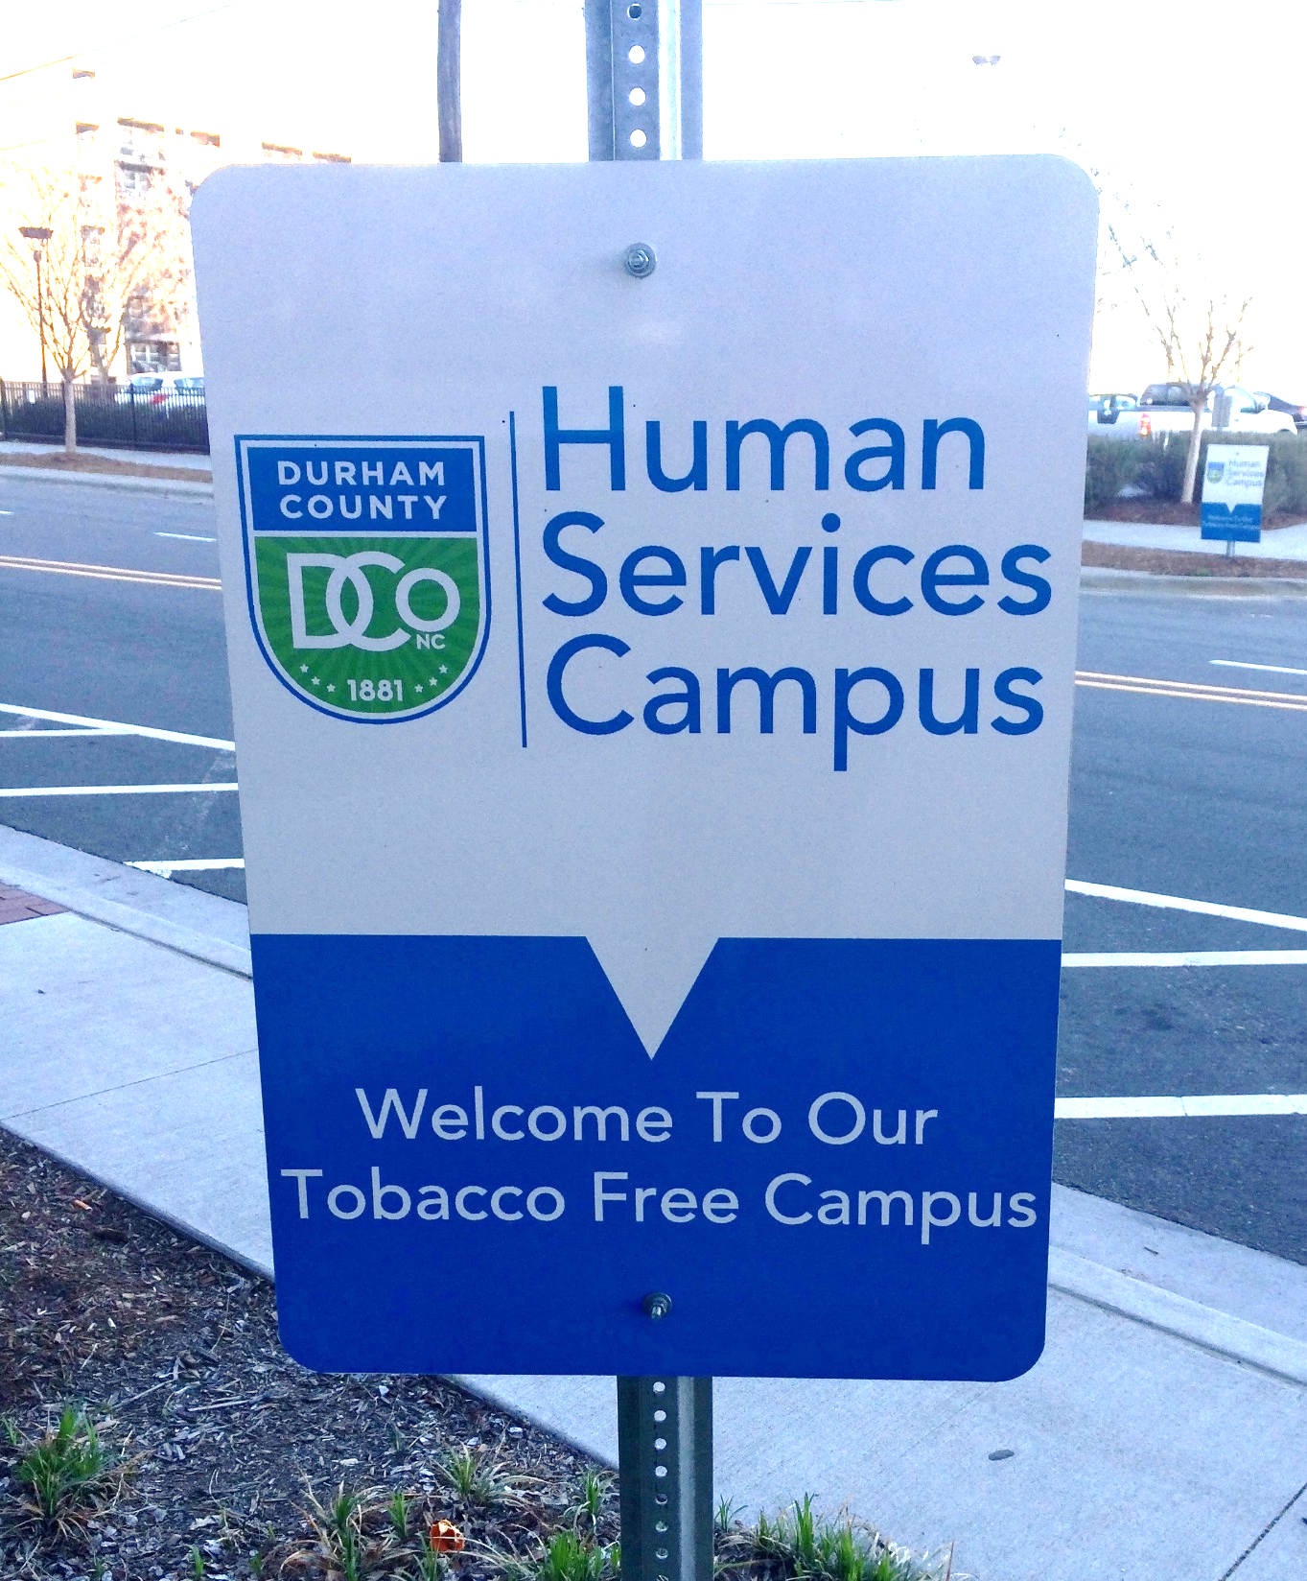
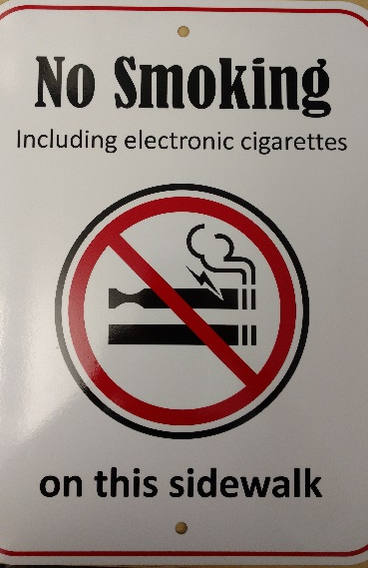
Durham County Smoke-Free Public Places Rule
Smoke-Free government buildings, vehicles and grounds
Smoke-Free public places
Now includes e-cigarettes
Notes:
Durham County was the first to adopt a comprehensive smoke-free public places rule in early 2012

Slide 41
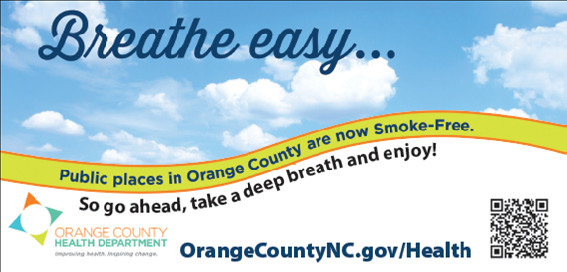

Orange County Smoke-Free Public Places Rule
Indoors - Where the public is invited or allowed
Regardless of public or private business ownership
Outside
Municipal or County owned/controlled property
Sidewalks
Parks and Recreation facilities
Bus Stops
Notes:
In fall 2012, Orange County became the second to adopt a comprehensive smoke-free public places rule.
Orange County Health Director Collen Bridger came up with the idea to activate smoking response teams, including youth, health dept. staff and volunteers to investigate areas where smoking complaints occur and educate the public about the smoke-free public places rule.

Slide 42

Enforcement is About Education
… “Support of the rule should be grassroots in nature, relying on peers and the community to educate smokers about compliance. By involving the community in educational efforts and encouraging them to engage in dialogue about healthy choices, there should be little or no need for actual enforcement.”
Communication
Signage
Cessation
Shift in cultural norms
Partners! Partners! Partners!
Notes:
No tickets have been written to date
Enforcement philosophy developed with police & partners
Similar to Mecklenburg – Orange achieves compliance through communication strategies, signage, and promoting cessation.

Slide 43

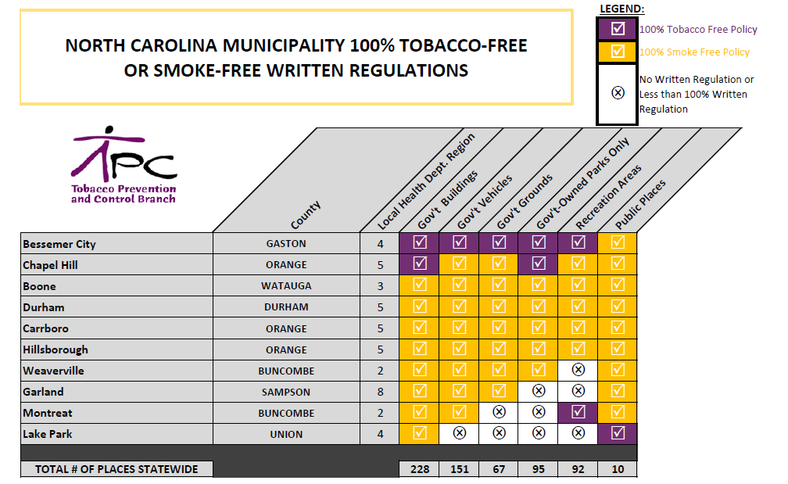
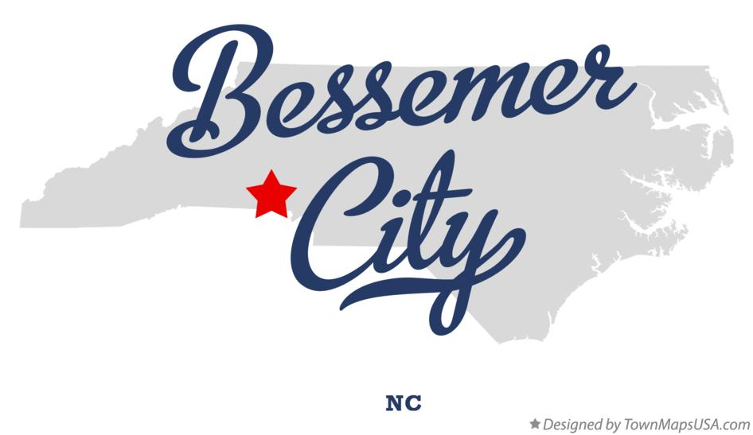
Bessemer City Has the Strongest Local Tobacco-Free Ordinance in the State
Notes:
Gaston County Health Director and health educators attended TPCB media / policy training
Bessemer City Manager personally “touched by tobacco” and is a champion for tobacco-free policy change
Bessemer City request dashboards of municipalities with smoke-free public places
TPCB develops message maps for public hearing
The strongest tobacco-free ordinance in the state is adopted on August 16, 2016

Slide 44
Call to Action
4
E-cigarettes
Presentations for local boards of health
Educate and inform decision-makers
Challenge Award

Slide 45
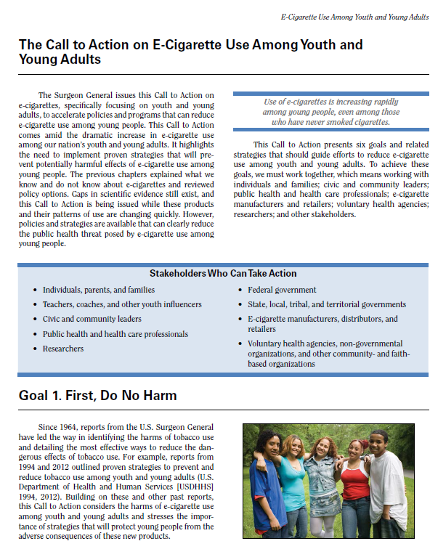
Call to Action
“…accelerate policies and programs that can reduce e-cigarette use among young people.”
“…implement proven strategies that will prevent potentially harmful effects of e-cigarette use among young people.”
Notes:
Slide courtesy of Dr. Brian King, CDC

Slide 46
Stakeholders Who Can Take Action
Teachers, coaches, and other youth influences
Civic and community leaders
Public health and health care professionals
Researchers
Federal government
State, local, tribal, and territorial governments
E-cigarette manufacturers, distributors, and retailers
Voluntary health agencies, non-governmental organizations, and other community and faith based organizations
Individuals, parents, and families
Notes:
Slide courtesy of Dr. Brian King, CDC

Slide 47


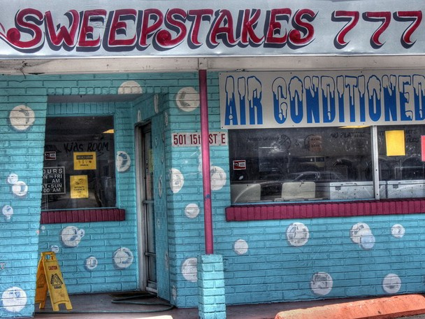
Where Do You Still See Smoking In Your Communities?
Notes:
Repair shop (Thinkstock 74854014), C-store (155357385)
The state routinely hears complaints about smoking in places like auto mechanic shops, sweepstakes parlors that still operate and mom and pop shops that don’t fall under the Smoke-free Restaurants and Bars Law.
Everyone should be protected from the dangers of secondhand smoke.
Photo credit: bing image search

Slide 48
What is Left Unchecked in Your Community?
Tobacco-free government buildings, vehicles, and grounds, including parks
Smoke-free public places, including e-cigarettes

Slide 49
Tobacco Prevention and Control Branch (TPCB) Funds Regions 2015-2020
3 – David Willard
828-264-4995
David.Willard@apphealth.com
7 – Michelle Mulvihill
919-250-1171
Catherine.Mulvihill@wakegov.com
5 – Mary Gillett
336-641-6000
mgillett@myguilford.com
9 – Lisa Phillips
252-475-5077
Lisa.Phillips@arhs-nc.org
2 – Karen Caldwell
828-620-1646
Karen.Caldwell@dhhs.nc.gov
Northampton
Gates
Camden
Ashe
Alleghany
Surry
Rockingham
Warren
Currituck
1 – Tobin Lee
828-349-2480
tobin@mountainwise.org
Stokes
Caswell
Person
Vance
Halifax
Hertford
Pasquotank
Mitchell
Watauga
Wilkes
Yadkin
Granville
Perquimans
Avery
Forsyth
Guilford
Orange
Franklin
Nash
Bertie
Chowan
Madison
Yancey
Caldwell
Alexander
Davie
Alamance
Durham
Edgecombe
Washington
Dare
Iredell
Martin
Tyrell
Dare
Buncombe
Burke
Davidson
Wake
Wilson
Tyrrell
Haywood
McDowell
Catawba
Rowan
Randolph
Chatham
Pitt
Beaufort
Swain
Hyde
Graham
Henderson
Rutherford
Lincoln
Lee
Johnston
Greene
Hyde
Jackson
Gaston
Cabarrus
Moore
Harnett
Cherokee
Macon
Transylvania
Polk
Cleveland
Stanly
Montgomery
Wayne
Lenoir
Craven
Clay
Mecklenburg
Cumberland
Pamlico
4 – Carleen Crawford
980-314-9142
Carleen.Crawford@mecklenburgcountync.gov
Union
Anson
Richmond
Hoke
Sampson
Jones
Scotland
Duplin
Carteret
Onslow
Robeson
Bladen
Pender
10 – Allyson Smith
252-902-2330
allyson.smith@pittcountync.gov
6 – Ashley Curtice
910-433-3852
acurtice@co.cumberland.nc.us
Columbus
New
Hanover
Lead Counties
Brunswick
1. Macon County Public Health
2. Rutherford-Polk-McDowell District Health Department
3. Appalachian District Health Department
4. Mecklenburg County Health Department
5. Guilford County Department of Health and Human Services, Public Health Division
6. Cumberland County Public Health Department
7. Wake County Human Services
8. Robeson County Department of Public Health
9. Albemarle Regional Health Services
10. Pitt County Health Department
8 – Ernest Watts
910-334-1488
ernest.watts@hth.co.robeson.nc.us
Local Tobacco Coordinators
Durham County Health Department – Natalie Rich, nrich@dconc.gov
Orange County Health Department – April Richard, arichard@orangecountync.gov
Mecklenburg County Health Department - Kim Bayha, Kimberly.bayha@mecklenburgcountync.gov

Slide 50
Resources
Local Government Smoke-Free Implementation Toolkit - http://www.tobaccopreventionandcontrol.ncdhhs.gov/lgtoolkit/index.htm
Business Pulse - www.cdcfoundation.org/businesspulse
The Community Guide - http://www.thecommunityguide.org/Tobacco/smokefreepolicies.html
UNC School of Government - http://canons.sog.unc.edu/?p=7788
U.S. Surgeon General’s Report on E-Cigarettes - https://e-cigarettes.surgeongeneral.gov/
TPCB Maps and Dashboards - http://www.tobaccopreventionandcontrol.ncdhhs.gov/maps/maps.htm

Slide 51
Contact the Tobacco Prevention and Control Branch
Sally Herndon, MPH
Branch Head
(919) 707-5401
sally.herndon@dhhs.nc.gov
Jim Martin, MS
Director of Policy and Programs
(919)707-5404
jim.martin@dhhs.nc.gov
Vacant
Director of Local Program
Development and Regulations
Anna Stein, JD, MPH
Legal Specialist
(919)707-5406
anna.stein@dhhs.nc.gov
Ann Staples, MA, MCHES
Director of Communication and Education
(704) 543-2347
ann.staples@dhhs.nc.gov
Joyce Swetlick, MPH
Director of Tobacco Cessation
(919)707-5402
joyce.swetlick@dhhs.nc.gov
Vacant
Tobacco Treatment Specialist
Courtney Heck, MPH
Director of Surveillance and Evaluation
(919) 707-5412
Courtney.Heck@dhhs.nc.gov

Slide 52

Creating Healthy, Tobacco-Free Communities: Challenge Award from the NC Association of Local Health Directors
For a local county, town or city government that adopts regulation(s) including:
Tobacco-free government buildings, vehicles, and grounds and smoke-free public places, including electronic cigarettes, without exemptions
The Award will be rotated as adopted regulations become effective. Bessemer City, NC was the most recent awardee!
Notes:
In 2017, the NC Association of Local Health Directors voted to give the Challenge Award to local counties and communities that adopt 100% smoke-free/tobacco free regulations in local governments buildings, grounds and public places. The award is in memory of the Tobacco Prevention and Control Branch Head Sally Herndon’s sister, who died due to exposure to secondhand smoke; she and earned the nickname Mighty Mouse on her volleyball team.
To be eligible for the Challenge Award, a local government would need to pass a regulation to the full extent allowable by NC law, that is, become smoke-free/tobacco free in local government buildings, grounds, and public places. Thus, county or city governments are eligible.
Winners to-date include:
Durham County
Orange County
Bessemer City

Slide 53
Questions

